Slide 1
Filament 5 render pass
chenkai at gmail.com
https://www.zhihu.com/people/kajiya-69
https://github.com/AndrewChan2022

Slide 2
Table of content
render pass data and flow
render pass data types
command generate and execute
render pass usage and example:
shadow pass/color pass/SSAO pass/SSR pass
post pass and color grading pass

Slide 3
render pass task
depth
scene.renderables
RenderPass
color
task: rasterizing scene renderables to depth and color render target
One class implement all kind of pass that rasterizing scene

Slide 4
render pass data
commands
generated command
renderable and ubo
object.{uniform, attribute, material}
RenderPass
camera.
position
to calc depth and sort command
renderFlag
config
variant

Slide 5
command data
command key
command
mi -- material instance
variant
primitive
raster
command data
buffer = {prim, morph, skin, instance}

Slide 6
render pass overall flow
command
config
renderpass.
generateCommand
sortCommand
renderpass.commands.
{key, prim}
renderpass.
execute
drawcall
scene.
renderable
renderpass.
setRenderable
renderpass.
ubo
generate and sort commands
execute commands

Slide 7
Why middle phase command
Decouple draw algorithm and draw code
old: sort renderable, then draw opaque, then draw transparent, if ssao, then…, if ssr, then …, if shadow, then…, if color, then… if transparent…
new: generate command, then sort command by algorithm and key
when algorithm change, no draw code change, only change sort
Decouple setup phase and execute phase
Setup phase package command key and data
Execute phase decode key and data to draw call

Slide 8
command generation - 1
pass variant
cmd.key
config
cmd type flag
render flag
generate
command
scene.depth
cmd.Prim =
{mi, variant, raster,
{prim, morph, skin, instance}}
camera.position
scene.renderable
renderable.mi.property
renderable.prim

Slide 9
Table of content
render pass data and flow
render pass data types
command generate and execute
render pass usage and example:
shadow pass/color pass/SSAO pass/SSR pass
post pass and color grading pass

Slide 10
render flags
stereoscopic
inverse front face
has shadow
3 bit
cmd.prim.raster.inverseFrontFace
cmd.prim.variant.SRE
cmd.prim.raster.depthWrite

Slide 11
Concept: material ~ material variant
$$L_{o}\left(x,ω_{o},λ,t\right)=L_{e}\left(x,ω_{0},λ,t\right)+\int_{Ω}{fr\left(x,ω_{i},ω_{o},λ,t\right)L_{i}\left(x,ω_{i},λ,t\right)\left(ω_{i}⋅n\right)dω_{i}}$$
emissive
bsdf
light transport
geometry falloff
material = surface bsdf property of render equation
material variant = full render equation = material + external env
Latex formula see ppt notes
Notes:
Latex equation: L_o(\mathbf{x}, \omega_{o}, \lambda,t) = L_e(\mathbf{x}, \omega_{0}, \lambda,t) + \int_{\Omega} fr(\mathbf{x}, \omega_{i}, \omega_{o}, \lambda,t) L_i(\mathbf{x}, \omega_{i}, \lambda,t) (\omega_{i} \cdot \mathbf{n}) d\omega_{i}, latex editor: word, latex online editor: https://latex.codecogs.com/eqneditor/editor.php

Slide 12
variant
STE
VSM
FOG/PCK
DEP
SKN
SRE
DYN
DIR
8bit
STE: instanced stereo rendering
SKN: skinning animation
VSM: variance shadow maps
SRE: shadow receiver
DIR: directional light
DYN: dynamic light, i.e. punctual light
DEP: depth only
FOG/PCK: PCK if DEP else FOG
FOG: post fog effect
PCK: picking
geometry stereo
geometry animation
light and shadow
post

Slide 13
command type flag
depth no
alpha blend object
depth no
alpha test object
depth has
shadow caster object
depth
color
5 bit
color
color
depth no
alpha blend object
color
SSR
depth has
shadow caster object
depth
shadow
depth no
alpha blend object
depth
SSAO

Slide 14
command key
CC = Channel
PP = Pass
a = alpha masking
ppp = priority
t = two pass transparency ordering
0 = reserved
TT = Type (pre, pass, post, sentinel)
PP
TT
22
32
pre custom
CC
00
PP
00
00
order
custom command index
PP
TT
6
10
32
pass.depth
CC
00
00
01
00
0
ppp
00
000000
z-bucket
material id
PP
TT
6
10
32
pass.color/refraction
CC
00
01
10
01
00
a
ppp
00
000000
z-bucket
material id
PP
TT
6
32
15
pass.blend
CC
00
11
01
00
0
ppp
00
000000
~distanceBit
blend order
t
PP
TT
22
32
post custom
CC
00
PP
10
00
order
custom command index
sentinel guard
11111111
11111111
11111111
11111111
11111111
11111111
11111111
11111111

Slide 15
Variant generation
pass variant
renderFlag.
hasShadow
Final command.prim.variant
recvShadow
renderable.mi.
property
hasSkin
hasMorph

Slide 16
Key generate
color pass
SSR pass
command type
shadow pass
SSAO pass
variant
command.key
renderFlag.hasShadow

Slide 17
Key generate 2
SST: Screen Space Refraction/Transmission
variant.DEP == 1 -> depth command
mat.has_SST -> refract cmd
mat.no_SST + opaque -> color cmd
transparentMode == default:
1 blend cmd: draw only to color
variant.DEP == 0
transparentMode == TWO_PASS_ONE_SIDE:
blend cmd 1: draw front face to depth, keep bigger
blend cmd 2: draw front face to color with depth test
mat.no_SST + transparent
transparentMode == TWO_PASS_TWO_SIDE:
blend cmd 1: draw back face to color
blend cmd 2: draw front face to color
https://google.github.io/filament/Materials.html#materialdefinitions/materialblock/blendingandtransparency:transparency

Slide 18
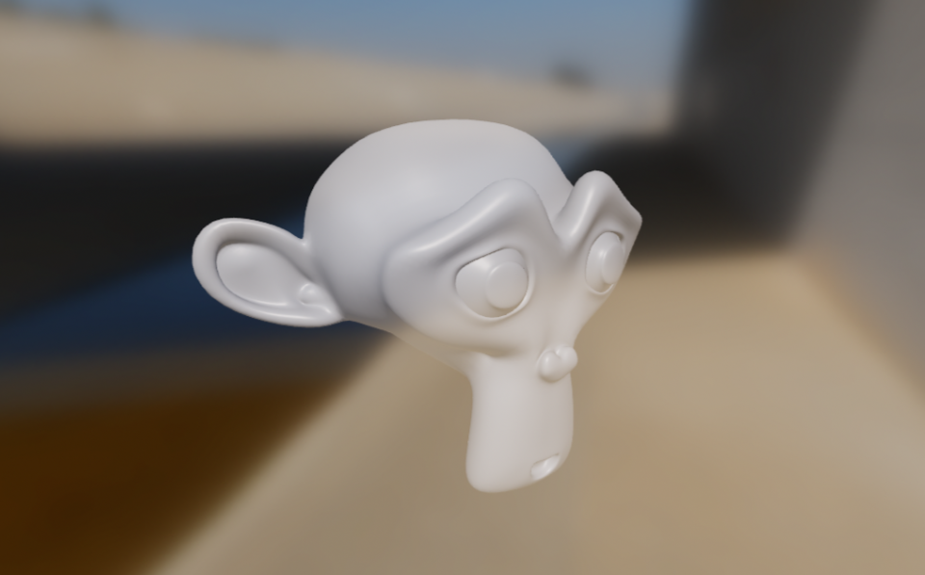
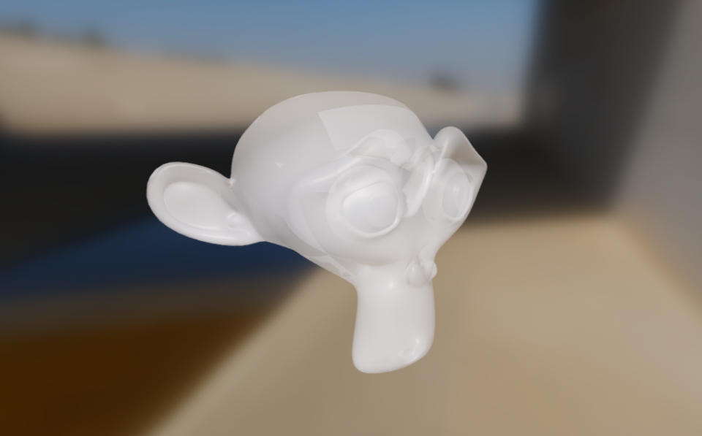
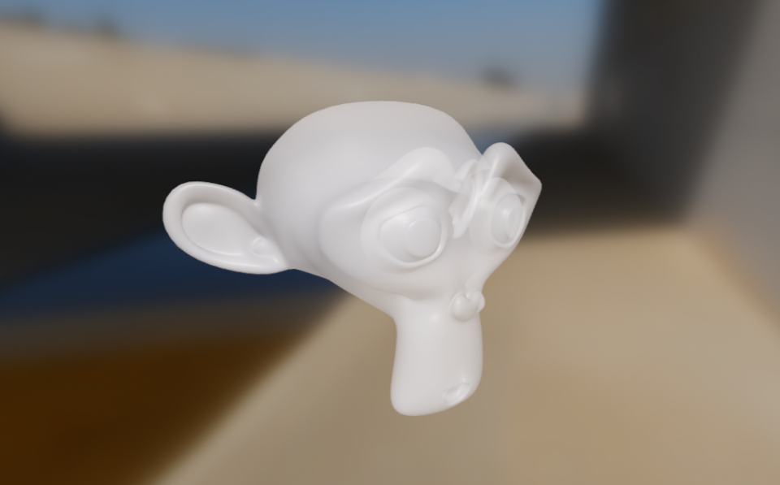
transparent mode
2 pass 1 side: occluded face not visible
Default + double side with sorting issue
occluded back face and front face also visible
image with links, if not visible please visit:
2 pass 2 side: both face visible, almost no sorting issue
https://google.github.io/filament/Materials.html#materialdefinitions/materialblock/blendingandtransparency:transparency

Slide 19
Table of content
render pass data and flow
render pass data types
command generate and execute
render pass usage and example:
shadow pass/color pass/SSAO pass/SSR pass
post pass and color grading pass

Slide 20
command generation - 2
SST: Screen Space Refraction/Transmission
render variant = pass variant
foreach renderable:
render variant += special renderable variant, such as receive shadow, morph, skin
foreach prim : renderable.primtives
// fill command.{key, prim{mi, variant, raster, {prim, skin, morph, instance}}}
if variant.DEP == 1: gen depth command
else
if mat.hasSST: gen refract command
if mat.noSST + opaque: gen color command
if mat.noSST + transparent:
if transparentMode == DEFAULT: gen blend command
if transparentMode == TWO_PASS_ONE_SIDE: gen 2 blend command
if transparentMode == TWO_PASS_TWO_SIDE: gen 2 blend command

Slide 21
command execute
mi = nullptr;
PipelineState pipeline;
foreach command:
if custom command:
index = command.getCustomIndex()
customCommand = mCustomCommands[index]
customCommand()
else:
info = command.primitive
if info.mi != mi: // mi changed
mi = info.mi
update and set per mi uniform and texture
pipeline.program = mi.getProgram(info.variant)
set per renderable uniform and texture
set geometry buffer
draw
generated variant
depth program should use less mi info
color program should more complex

Slide 22
Table of content
render pass data and flow
render pass data types
command generate and execute
render pass usage and example:
shadow pass/color pass/SSAO pass/SSR pass
post pass and color grading pass

Slide 23
Usage
Renderpass pass;
pass.setRenderFlags
pass.setVariant of renderable unrelated variant
pass.appendCommands with commandTypeFlag(shadow/color/SSAO/SSR)
pass.sortCommands
pass.execute

Slide 24
Example: shadow pass - code
Renderer.cpp/ShowMapManager.cpp
// copy color pass to shadow pass
RenderPass shadowPass(pass);
// set renderable unrelated variant
Variant shadowVariant(Variant::DEPTH_VARIANT);
shadowVariant.setVsm(view.getShadowType() == ShadowType::VSM);
// clone one
RenderPass pass(shadowPass);
// set scene data and renderable
pass.setCamera(cameraInfo); pass.setVisibilityMask(…); pass.setGeometry(…);
// gen command pass.appendCommands(engine, RenderPass::SHADOW);
pass.sortCommands(engine);

Slide 25
Example: shadow pass – gen command
Variant::DEPTH_VARIANT
DEP = 1
CommandTypeFlags::SHADOW
DEPTH | SHADOW CASTER
foreach object cast shadow:
gen depth command
RenderFlags::HAS_SHADOWING
HAS_SHADOWING
View.has_shadowing

Slide 26
Example: color pass - code
Renderer.cpp/RendererUtils.cpp
RenderPass pass;
// set renderFlag
RenderPass::RenderFlags renderFlags = 0;
renderFlags |= RenderPass::HAS_SHADOWING if view.hasShadowing()
...
pass.setRenderFlags(renderFlags);
// set renderable unrelated variant
Variant variant; // DEP = 0
variant.set...
pass.setVariant(variant);
// set scene
pass.setCamera(cameraInfo); pass.setGeometry(...);
pass.appendCommands(engine, RenderPass::COLOR);
pass.sortCommands(engine);

Slide 27
Example: color pass – gen command
Variant
DEP = 0
foreach object:
if hasSST -> refract command
if noSST + opaque -> color command
if noSST + transparent -> switch transparent
CommandTypeFlags::SHADOW
COLOR
RenderFlags::HAS_SHADOWING
HAS_SHADOWING
View.has_shadowing
Default: 1 blend command write to color
2 pass 2 side:
blend 1 command: back face to color
blend 2 command: front face to color
transparent mode
2 pass 1 side:
blend 1 command: front face to depth
blend 2 command: front face to color + depth test

Slide 28
Example: SSAO pass, structure pass
PostProcessManager.structure
// copy color pass
renderPass = pass
// set variant
Variant structureVariant(Variant::DEPTH_VARIANT);
structureVariant.setPicking(config.picking);
renderPass.setVariant(structureVariant);
// set renderFlag
renderPass.setRenderFlags(structureRenderFlags);
renderPass.appendCommands(mEngine, RenderPass::CommandTypeFlags::SSAO);
renderPass.sortCommands(mEngine);
auto out = resources.getRenderPassInfo();
renderPass.execute(mEngine, resources.getPassName(), out.target, out.params);

Slide 29
Example: SSAO pass – gen command
Variant::DEPTH_VARIANT
DEP = 1
CommandTypeFlags::SHADOW
DEPTH | FILTER_TRANSLUCENT
foreach opaque object:
gen depth command
RenderFlags::HAS_SHADOWING
HAS_SHADOWING
View.has_shadowing

Slide 30
Example: SSR pass - code
PostProcessManager.ssr
// copy color pass
renderPass = pass
// renderflag
flags &= ~RenderPass::HAS_SHADOWING;
renderPass.setRenderFlags(flags);
// variant
renderPass.setVariant(Variant{Variant::SPECIAL_SSR}); // VSM | SRE
renderPass.appendCommands(mEngine, RenderPass::CommandTypeFlags::SCREEN_SPACE_REFLECTIONS);
renderPass.sortCommands(mEngine);
renderPass.execute(mEngine, resources.getPassName(), out.target, out.params);

Slide 31
Example: SSR pass – gen command
Variant::SSR
DEP = 1 | VSM | SRE
CommandTypeFlags::SSR
foreach opaque object:
if hasSST -> refract command
if noSST + opaque -> color command
COLOR | FILTER_TRANSLUCENT
RenderFlags::HAS_SHADOWING
HAS_SHADOWING
View.has_shadowing

Slide 32
Table of content
render pass data and flow
render pass data types
command generate and execute
render pass usage and example:
shadow pass/color pass/SSAO pass/SSR pass
post pass and color grading pass

Slide 33
post pass and color grading pass
color
color
post pass
quad geometry
task: process color texture
Should use compute pass

Slide 34
summary
color pass
SSR pass
command type flag
shadow pass
SSAO pass
renderFlag.hasShadow
cmd.key
sort
pass variant
variant
cmd.prim.variant
program
hasSkin
draw
renderable.mi
hasMorph
cmd.prim.mi
recvShadow
cmd.prim.buffer
vao
renderpass.ubo
ubo/texture
renderable

Slide 35
issues
Is necessary for all kink of rasterizing pass in 1 class?
Balance complexity with code reusage
With ray tracing and BTDF/volume added, how this class modified?

Slide 36
Further reading
How Falcor organize the render pass
How unreal organize the render pass

